Slide 1
爱尔兰驻华大使馆 (Embassy of Ireland)
Enhancing Sustainability = The Critical Driver in Future Dairy Development
加强可持续发展
未来乳业发展的关键动力
2024年6月13日 北京 13th June 2024 Beijing

Slide 2
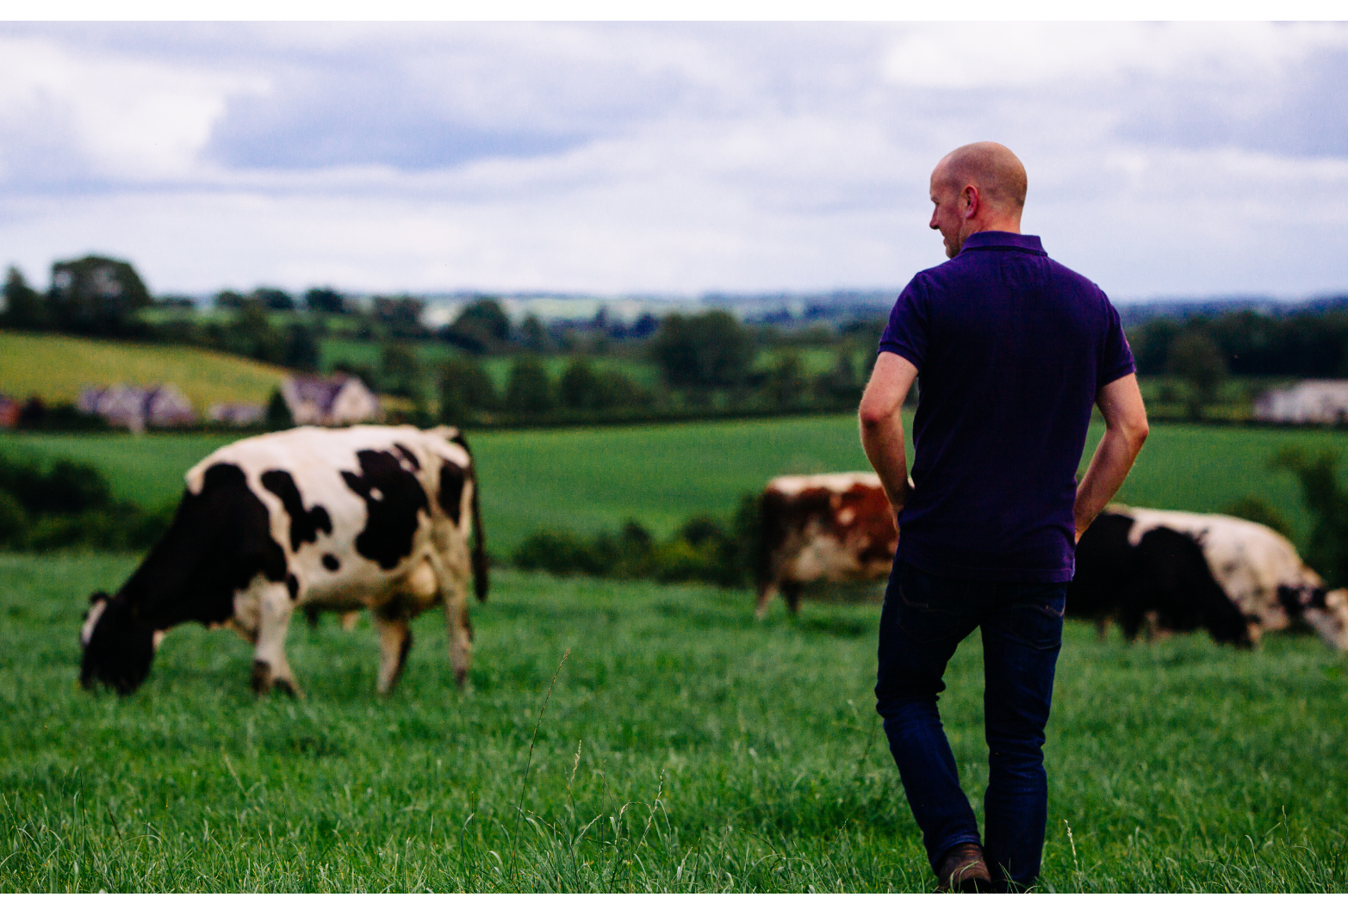
Ireland at the forefront of animal husbandry worldwide爱尔兰处于世界畜牧业领先地位
Temperate climate气候温和
80% of Ireland is given over to pasture爱尔兰的草地占比80%
Low density family farm model低密度家庭农场模式
Animal health and welfare动物健康与福利

Slide 3


Origin Green绿色本源
Initiated by Bord Bia, audited by Department of Agriculture, Food and the Marine由爱尔兰食品局发起，由爱尔兰农业食品海事部监督
Over 95% of Irish dairy exports are produced in Origin Green herds超过95%的爱尔兰出口乳品是由源于绿色项目的牛群生产的
Enabling food to be produced in a sustainable way that protects natural resources保护自然资源，让食品以可持续发展的方式生产

Slide 4
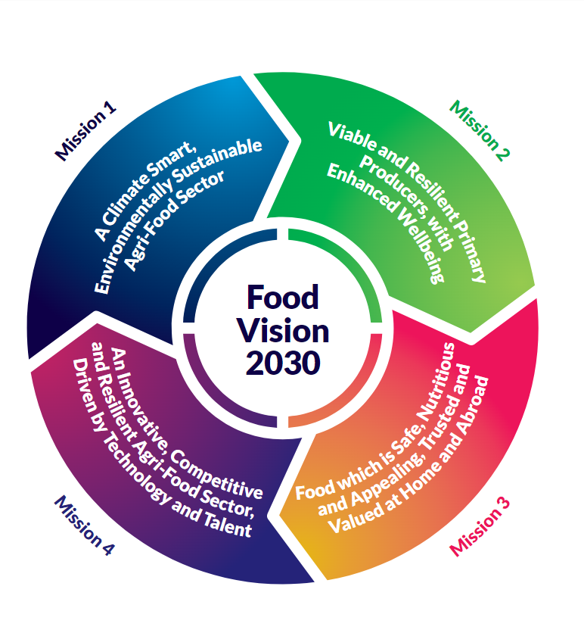
Food Vision 2030 食品展望2030
Ireland to become a world leader in Sustainable Food systems爱尔兰将成为可持续发展食品系统世界领导者
Delivering significant benefits for the Irish agri-food sector and society利好爱尔兰农业食品领域和社会发展
Sustainability in economy, society and environment实现经济、社会、环境可持续发展

Slide 5

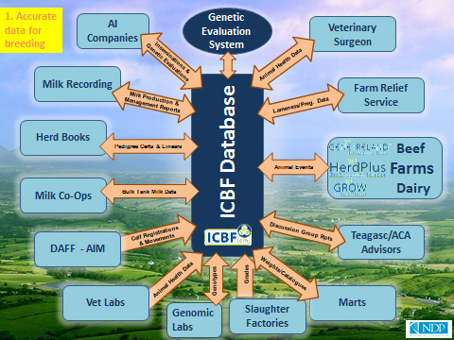
Irish Cattle Breeding Federation(ICBF) 爱尔兰牛群育种协会
Non-profit, industry leading organization 非营利行业领先组织
Improved breeding to reduce carbon emission 通过筛选育种来减少碳排放
First carbon sub-index released in 2022 首个碳指数于2022年发布

Slide 6
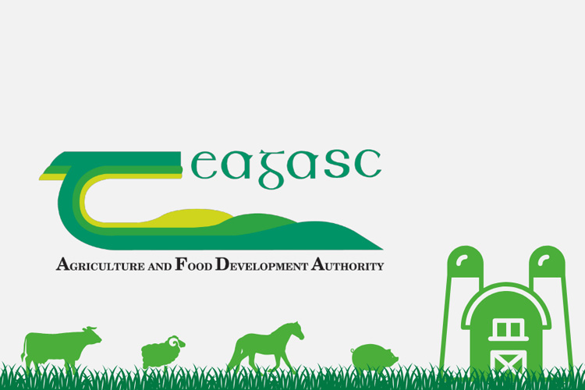
农业食品发展署

Slide 7
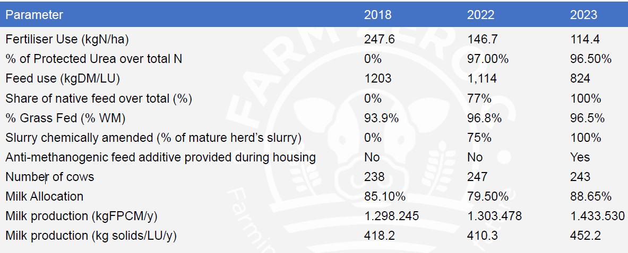
Farm Zero C – Progress to Date

Slide 8
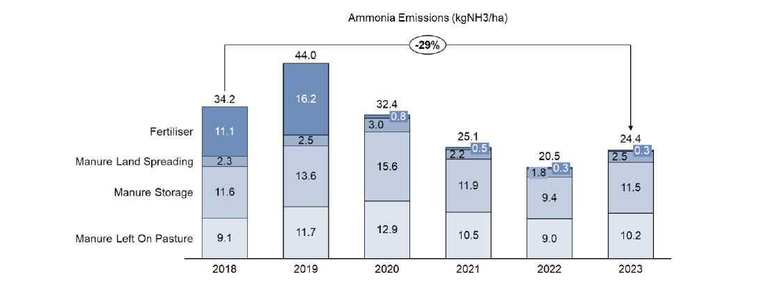
Farm Zero C
Ammonia Emissions Reduction 2018 - 2023

Slide 9
Play Video

Slide 10

谢谢！Thanks！
Twitter: @irlembchina
www.embassyofireland.cn

