Slide 1
联邦食品链安全局
Building dairy trade confidence: Belgian risk-based controls
构筑乳品贸易信任：比利时基于风险分析的监管
Annabelle Schreiber 石安妮
Agricultural attaché – Food Safety & SPS matters
农业参赞 – 负责食品安全和动植物检疫事务

Slide 2
Federal Agency for the Safety of the Food Chain 保护食品链安全的联邦机构
Federal agency ensuring food safety "from farm to fork" through risk-based controls, scientific advice, and crisis management.
基于风险控制、科学建议和危机管理，联邦机构确保“从农场到餐桌”的食品安全。
Key missions: Official inspections, product recalls, lab analysis, operator authorization.
主要任务：官方检查、产品召回、实验室分析、经营者授权。
Legal Basis: EU Regulation + Belgian laws.
法律依据：欧盟法规 + 比利时法律

Slide 3
01
Mandatory registration for all Belgian producers
所有比利时生产商必须进行注册

Slide 4
Mandatory registration for all Belgian producers 所有比利时生产商必须进行注册
Legal Requirement: Every Belgian operator (large/small) must register in FASFC database.
法律要求：所有比利时经营者（无论规模大小）均须在联邦食品链安全局 (FASFC) 数据库中注册。
Includes:
Physical stores, online shops, and production sites.
Even online-only businesses without physical stores.
包括：
实体门店、线上商店和生产厂址。
即使是没有实体门店的线上商店。

Slide 5
02
Inspection of Belgian producers
对比利时生产商的检查

Slide 6
Risk-Based Control Framework 基于风险的监管框架
Core Principle 核心原则：
Inspection frequency/intensity ∝ risk level (product type, operator history).
检查频率/强度 ∝ 风险等级（产品类型、经营者历史记录）。
Tools 工具：
Database : Centralized operator registry.
数据库：集中式经营者注册登记系统
Checklists : Objective scoring of compliance.
检查清单：客观的合规性评分

Slide 7
Inspection chronology 检查流程
1- Pre-inspection 预先检查
Check database for operator data + activity-specific checklists.
查询数据库获取经营者数据 + 特定的经营活动检查清单。
2- Administrative control 行政监管
Verify legal documents, registered activities.
核实法律文件、注册活动。
3- On-site checklist review 现场检查清单审核
Evaluate infrastructure, traceability, labeling, etc.
评估基础设施、可追溯性、标签等。
4- Feedback session 反馈
Discuss findings (compliant/non-compliant points).
讨论检查结果（合规/不合规项）。

Slide 8
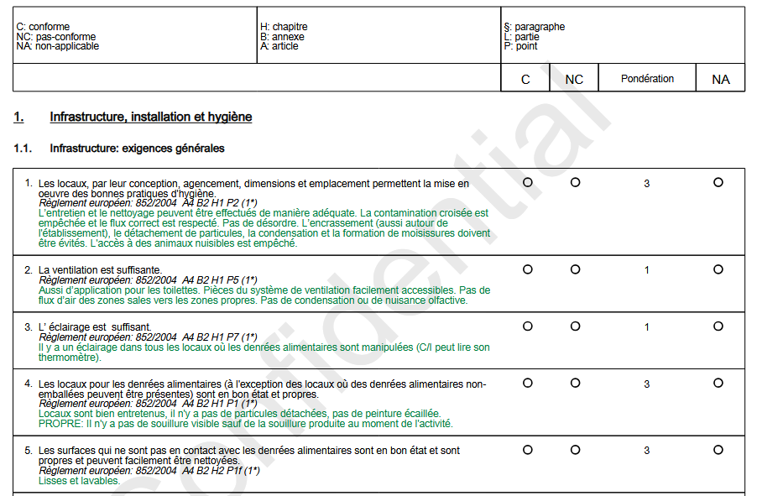
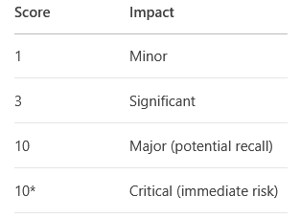
Checklists & Scoring 检查清单与评分
Key Scopes 主要范围:
Infrastructure/Hygiene, Self-Control (HACCP), Traceability, Labeling.
基础设施/卫生、自控体系 (HACCP)、 追溯性、标签。
Weighting System 评分体系:

Slide 9
Inspection Outcomes 检查结果判定
Decision matrix 决策矩阵
Non-Conformities 不合规 (NC) | Action 措施 | Result 结果
≥1 NC = 10* | Prosecution 立案 | Non-Favorable 不合格
≥1 NC = 10 + Total NC% >20% | Prosecution 立案 | Non-Favorable 不合格
≥1 NC = 3 + Total NC% >20% | Warning 警告 | Non-Favorable 不合格
Only NC = 1 / No NC | None 无 | Favorable 合格

Slide 10
Inspection Frequency 检查频率
Risk-Based Adjustment 机遇风险调整
Base frequency ↑ if poor compliance history; ↓ if validated self-control (e.g., HACCP).
基础频率 ↑ 如果历史合规性差 ；↓ 如果有有效自控体系（如HACCP）。
Example (Dairy Sector)
Cheese producers: 1-2 inspections/year (base).
举例（乳品行业）
奶酪生产商：基础频率 1-2次/年。

Slide 11
Sampling & Analysis 采样与分析
When? Suspicion of risk or routine monitoring.
何时？有疑似风险时或常规监测时。
Parameters 检查项目
Pathogens (Listeria, E. coli), contaminants, labeling accuracy.
致病菌（李斯特菌、大肠杆菌）、污染物、标签准确性。
Process 流程
Samples → Accredited lab → Legal action if non-compliant.
样品 → 认可实验室 → 不合规时采取法律措施。

Slide 12
Case Background 案例背景
Operator : soft cheese producer
经营者：软质奶酪生产商
Inspection Trigger : Routine risk-based control
检查触发：基于风险的常规检查
Scope: Infrastructure + Traceability
范围：基础设施 + 追溯性

Slide 13
Key Findings 检查结果
Critical NC (10*) 重大不合规(10*) :
No temperature logs in maturation room → Risk of Listeria growth.
成熟室无温度记录 → 李斯特菌繁殖风险。
Major NC (10) 严重不合规 (10) :
Batch traceability incomplete (missing supplier milk records).
批次追溯不全（缺失原料奶供应商记录）。
Minor NC (1) 轻微不合规 (1) :
Handwashing signage not visible.
洗手标识不明显。

Slide 14
Outcome & Actions 处理结果与措施
Result :
Non-Favorable (1 NC=10* + 1 NC=10 → Prosecution).
不合格（ 1 NC=10* + 1 NC=10 → 立案）。
Enforcement 执行措施 :
Production suspension until corrective actions; Follow-up inspection in 15 days.
停产直至整改；15 天后复查。
Trade Impact 贸易影响 :
Export license suspended until compliance.
合规前暂停出口许可。

Slide 15
Lessons for Trade Confidence 贸易信心启示
Proactive Compliance 主动合规 :
Use FASFC checklists for self-audits → Avoid 10/10* NCs.
用 FASFC 检查清单自审 → 避免 10/10* 级不合规。
Transparency 透明性 :
Full traceability builds buyer trust.
完整追溯体系增强买家信心。
FASFC as partner 联邦食品链安全局作为合作伙伴:
Early consultation prevents crises.
提前咨询预防危机。

Slide 16
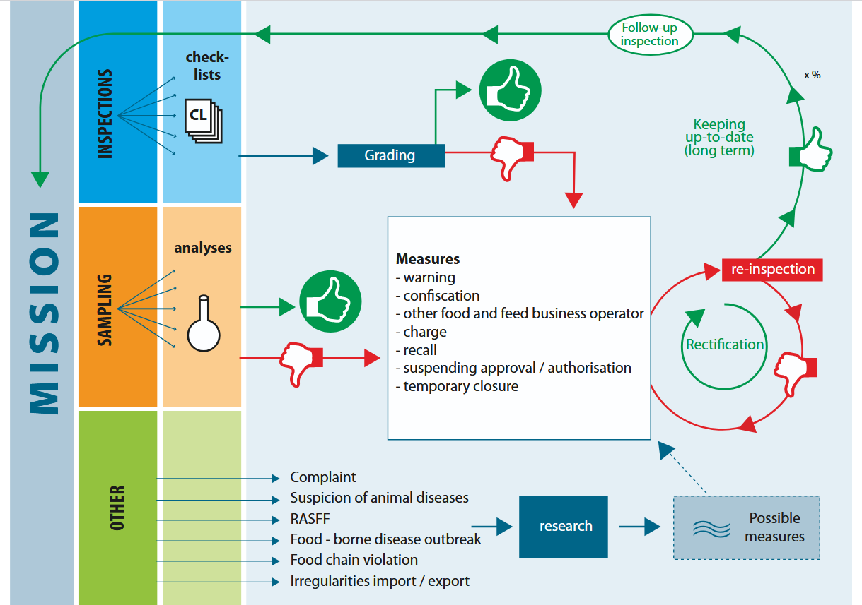

Slide 17
Transparency: Inspection results are public! 透明性： 检查结果全部公示！

Slide 18
From Belgian Farms to Chinese Homes: Guaranteeing Safety at Every Step 从比利时农场到中国家庭：确保每一步的安全
On-Site inspections: Rigorous physical audits ensure Belgian producers meet EU standards before export.
现场检查：严格的现场审核确保比利时生产商在出口前符合欧盟标准。
Mandatory registration: Every Belgian operator tracked – no anonymous sellers. Full transparency.
强制注册：所有比利时经营者均需注册——无匿名卖家。完全透明。
Integrated approach (physical + digital) enforces compliance across borders, reducing risks like counterfeit or non-compliant goods.
整合管理（现场与电子信息）可跨国界确保合规，从而减少假冒或不合规商品等风险。

Slide 19
Federal Agency
for the Safety of the Food Chain
Thank you
谢谢
TOGETHER TOWARDS
A SAFER FOOD CHAIN
携手共创更安全的食品链

