Slide 1
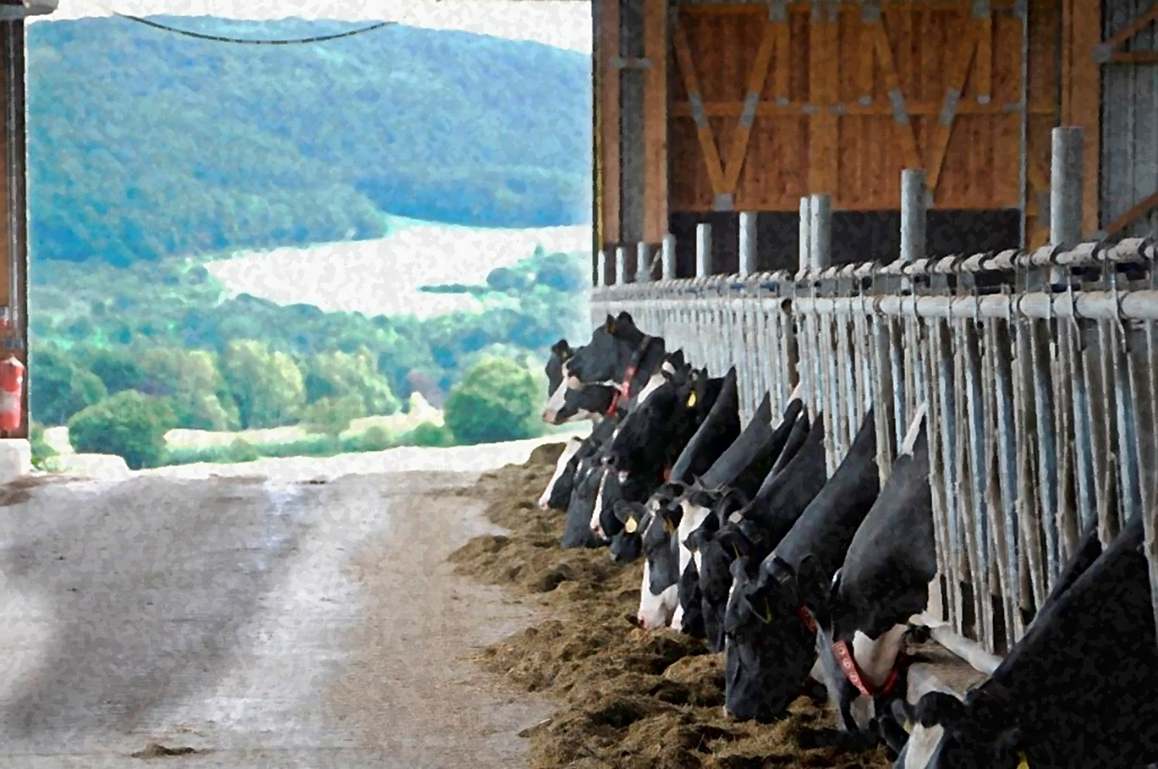
Friederike Dörfler Counsellor for Food and Agriculture German Embassy, Beijing

Slide 2
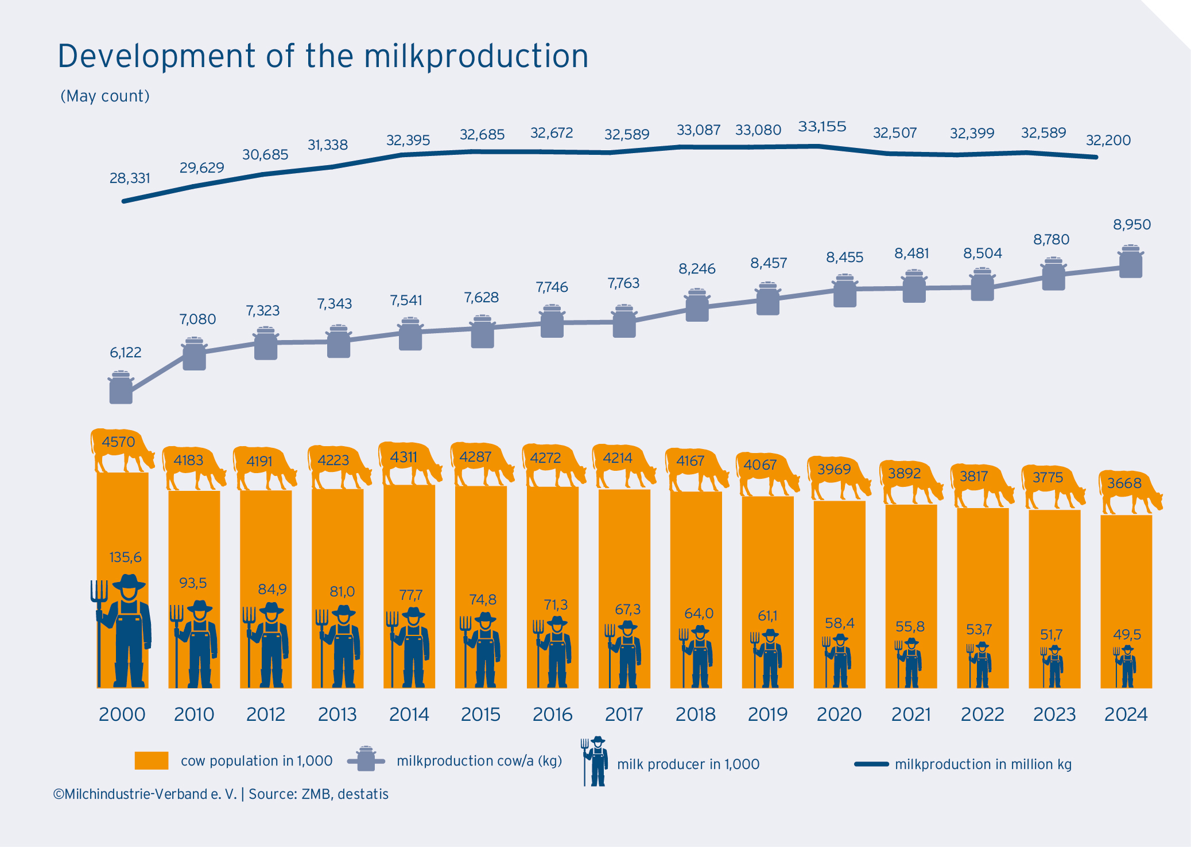
Continued Structural Change and a Reliable Forecast
Stable production despite decreasing dairy cow numbers.
Ongoing farm consolidation drives efficiency.
Cows per holder increasing.
Notes:
Total milk production has remained relatively stable (~32 million tons annually) over two decades.
This is remarkable given the 25% reduction in dairy cow numbers since 2000 (from ~4.6M to ~3.7M).
Higher per-cow yields (+30% since 2000) have compensated for the decline in herd size.
→ This reflects genetic improvement, better feed, and precision herd management.
Number of milk producers fell by more than 60% from ~135,600 in 2000 to ~49,500 in 2024.
The sector is becoming more professionalized: larger farms, more technology, fewer but more specialized operators.
Average herd size doubled, now ~75 cows per farm (compared to 35 in 2000). IT IS INDEED COMPARABLY SMALL WHEN COMPARING TO CHINA
This structural trend is economically necessary due to rising costs and market pressure, but it also raises debates about regional balance and rural resilience.
Rise in herd size per producer – signaling capital-intensive dairy farming.
Germany now has a dual structure:
Large, tech-driven farms (mainly in the North and East)
Smaller family farms, especially in Bavaria and Baden-Württemberg, some focusing on organic or added-value segments.
This structural shift aligns with EU-wide trends, but Germany still has a more regionally diverse dairy base than countries like the Netherlands or Denmark.
Policy challenge: Ensuring sustainability, animal welfare, and generational renewal despite ongoing consolidation.
SUM:
Fewer farms, fewer cows, higher productivity, stable milk production – Germany’s dairy sector is evolving, but still rooted in regional strength.

Slide 3
Uncompromising Quality & Safety in German Dairy
Notes:
Food law:
German dairies operate under the overarching framework of the EU General Food Law Regulation (EC) No 178/2002, which sets the foundation for food safety, traceability, and risk management across the EU.
Supplemented by the EU Hygiene Package:
Regulation (EC) No 852/2004: Hygiene of foodstuffs
Regulation (EC) No 853/2004: Specific hygiene rules for food of animal origin
Regulation (EC) No 854/2004 (replaced by EU Regulation 2017/625): Official controls
German dairies are also subject to national implementation via the Lebensmittel- und Futtermittelgesetzbuch (LFGB) and Tier-LMHV (animal based food hygiene regulation).
2) Residue / Contaminant:
Legal basis:
Regulation (EC) No 396/2005 on maximum residue levels (MRLs) of pesticides
Regulation (EU) 37/2010 on pharmacologically active substances in food-producing animals
Coordinated by the Federal Office of Consumer Protection and Food Safety (BVL) and monitored via the National Residue Monitoring Plan (NRKP). Exceedances are rare and lead to immediate trace back and withdrawal –ensuring trust in German dairy exports.
3) Technology Expertise: German dairies benefit from long-standing investment in food technology, HACCP systems, and digital monitoring.Compliance with Regulation (EC) No 852/2004 mandates HACCP (Hazard Analysis and Critical Control Points) systems.Advanced inline control systems and process automation ensure real time quality assurance. Specialized production (e.g. whey protein isolates, infant-grade milk powder) follows Codex Alimentarius and (often) Chinese GB Standards, enabling access to high-barrier export markets. The Max Rubner Institut (MRI) supports scientific advancement in dairy processing, food safety, and nutrition – serving as a key federal research body under the German Ministry of Food and Agriculture.
4) Animal Welfare: Animal health and welfare are embedded in EU law and reinforced nationally: Council Directive 98/58/EC on the protection of animals kept for farming purposes; German Animal Welfare Act (Tierschutzgesetz) sets higher national standards, particularly for housing and veterinary care. Voluntary programs like QM-Milch and Pro Weidelandgo beyond minimum legal standards, promoting welfare, pasture access, and responsible antibiotic use.

Slide 4
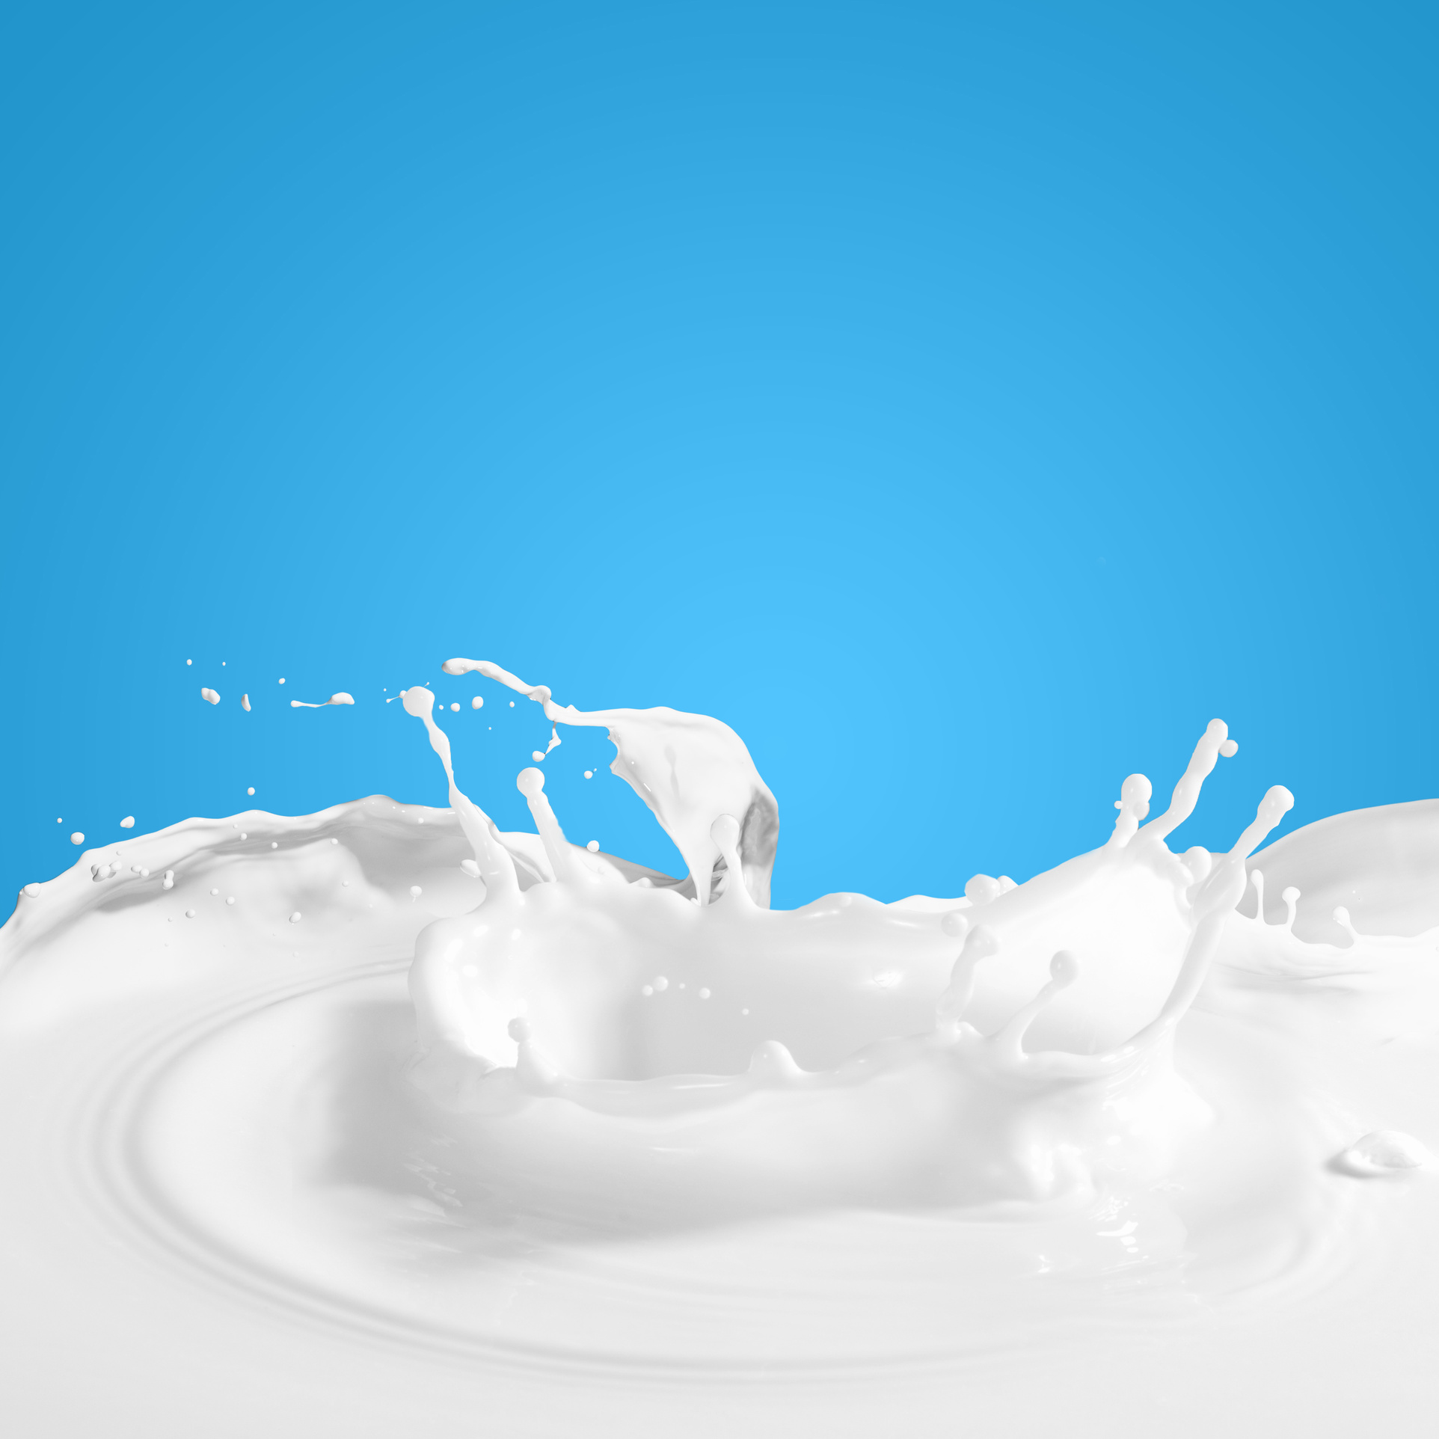
Innovating for Modern Consumers – Sport & Health
High-Protein & Functional Products
Protein-enriched drinks, yogurts, quark
Products with added vitamins, probiotics, immune support
The global sports nutrition market was valued at approximately USD 45 billion in 2023 and is expected to grow to around USD 75 billion by 2030, with a compound annual growth rate (CAGR) of about 7.5%. Source: Grand View Research
Free-From & Digestive-Friendly
Lactose-free milk & cheese
A2 milk and enzyme-enhanced digestibility
Globally, 3 / 4 consumers have an interest in food products that improve gut health. Source: Foodnavigator
Notes:
1.1) often enriched with vitamins, probiotics, or immune-supporting ingredients to meet active lifestyle and health trends
1.2) Functional lines include added probiotics and immune-supporting nutrients (e.g. vitamin D). High-protein milk drinks like "protein+ fiber" blends are a growing export category to China. (renowned brands in GER: Müller and Ehrmann offer high-protein yogurts and puddings for active lifestyle)
2.1) Lactose-free milk is made by adding the enzyme lactase to regular milk, which breaks down lactose (milk sugar) into glucose and galactose—simpler sugars that are easier to digest. This process makes the milk suitable for lactose-intolerant individuals without changing its nutritional value.
2.2) (NOTE: Not mainstream in Germany, much more so in China! A2 milk comes from cows that naturally produce only the A2 type of beta-casein protein, instead of the more common A1 and A2 mix. Some studies suggest A2 milk may be easier to digest for people who experience discomfort from regular milk, even if they’re not lactose intolerant.) Sourced from herds tested to produce the A2 beta-casein variant. Demand slowly growing, especially among consumers with milk discomfort who don’t have lactose intolerance, and in export markets like China, where A2 milk enjoys premium positioning.

Slide 5
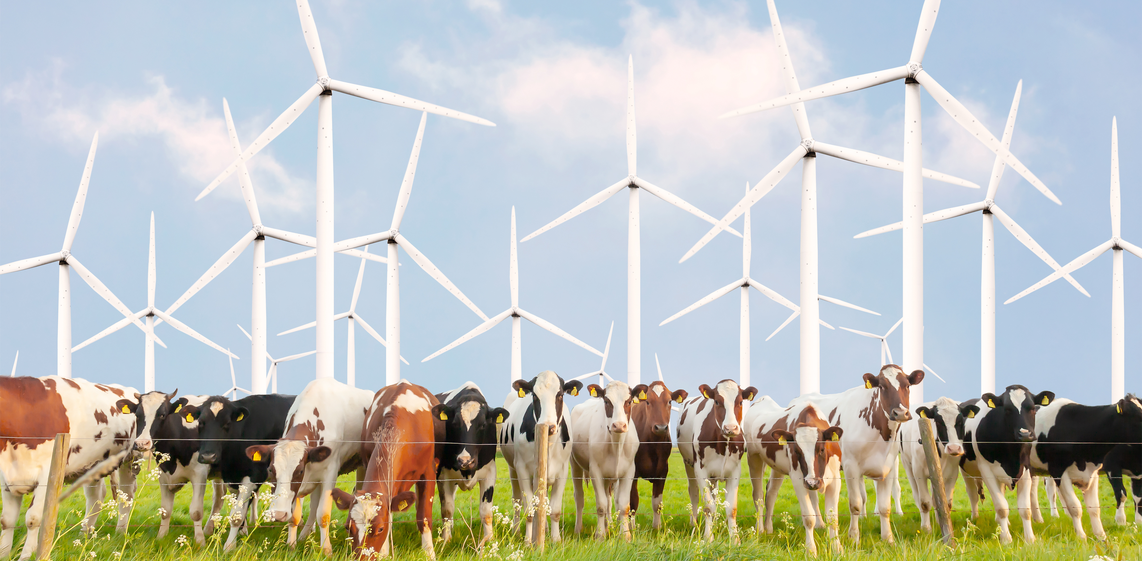
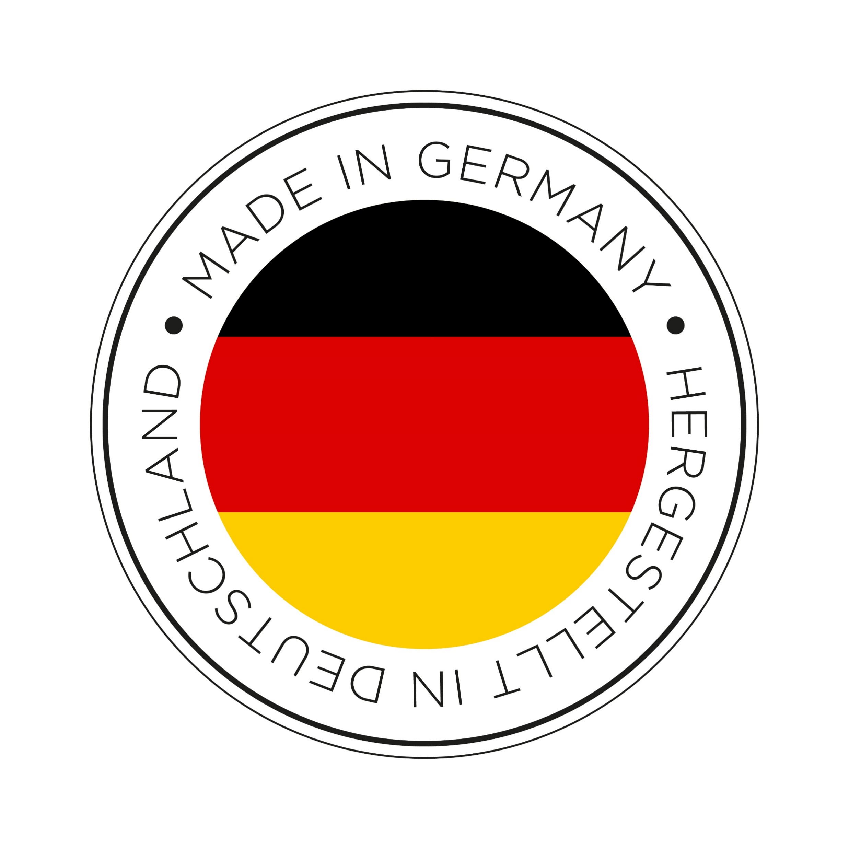
Trusted Partner for Global Markets – Including China
Certified Quality for Export
Adaptable to Local Demands
Cold Chain & Logistics Excellence
Reputation &
Reliability
Sustainability &
Climate Responsibility
Notes:
WHY GERMANY?
Certified Quality for Export:
German dairy companies meet the world’s most demanding import standards, including China’s customs and registration requirements (e.g. GACC, CIFER system).
Cold Chain & Logistics Excellence:
Germany's modern cold-chain systems, certified logistics partners, and well-connected ports (Hamburg, Bremen) ensure fast, fresh, and reliable delivery worldwide.
Adaptable to Local Demands:
Exporters offer tailored formats (e.g. UHT milk, infant formula base, clean-label cheese), meeting China's growing demand for nutritional, safe, and traceable food.
Reputation & Reliability: ESPECIALLY POLITICAL RELIABILITY, SEE USA!
German dairy stands for "Made in Germany" excellence — synonymous with safety, traceability, and consistent high quality.
Sustainability: nearly 40% of dairy farms use renewable energy (solar, biogas); EU brought forward several regulations covering sustainability within the Farm to Fork framework (CSRD, CBAM, EUDR etc)

Slide 6
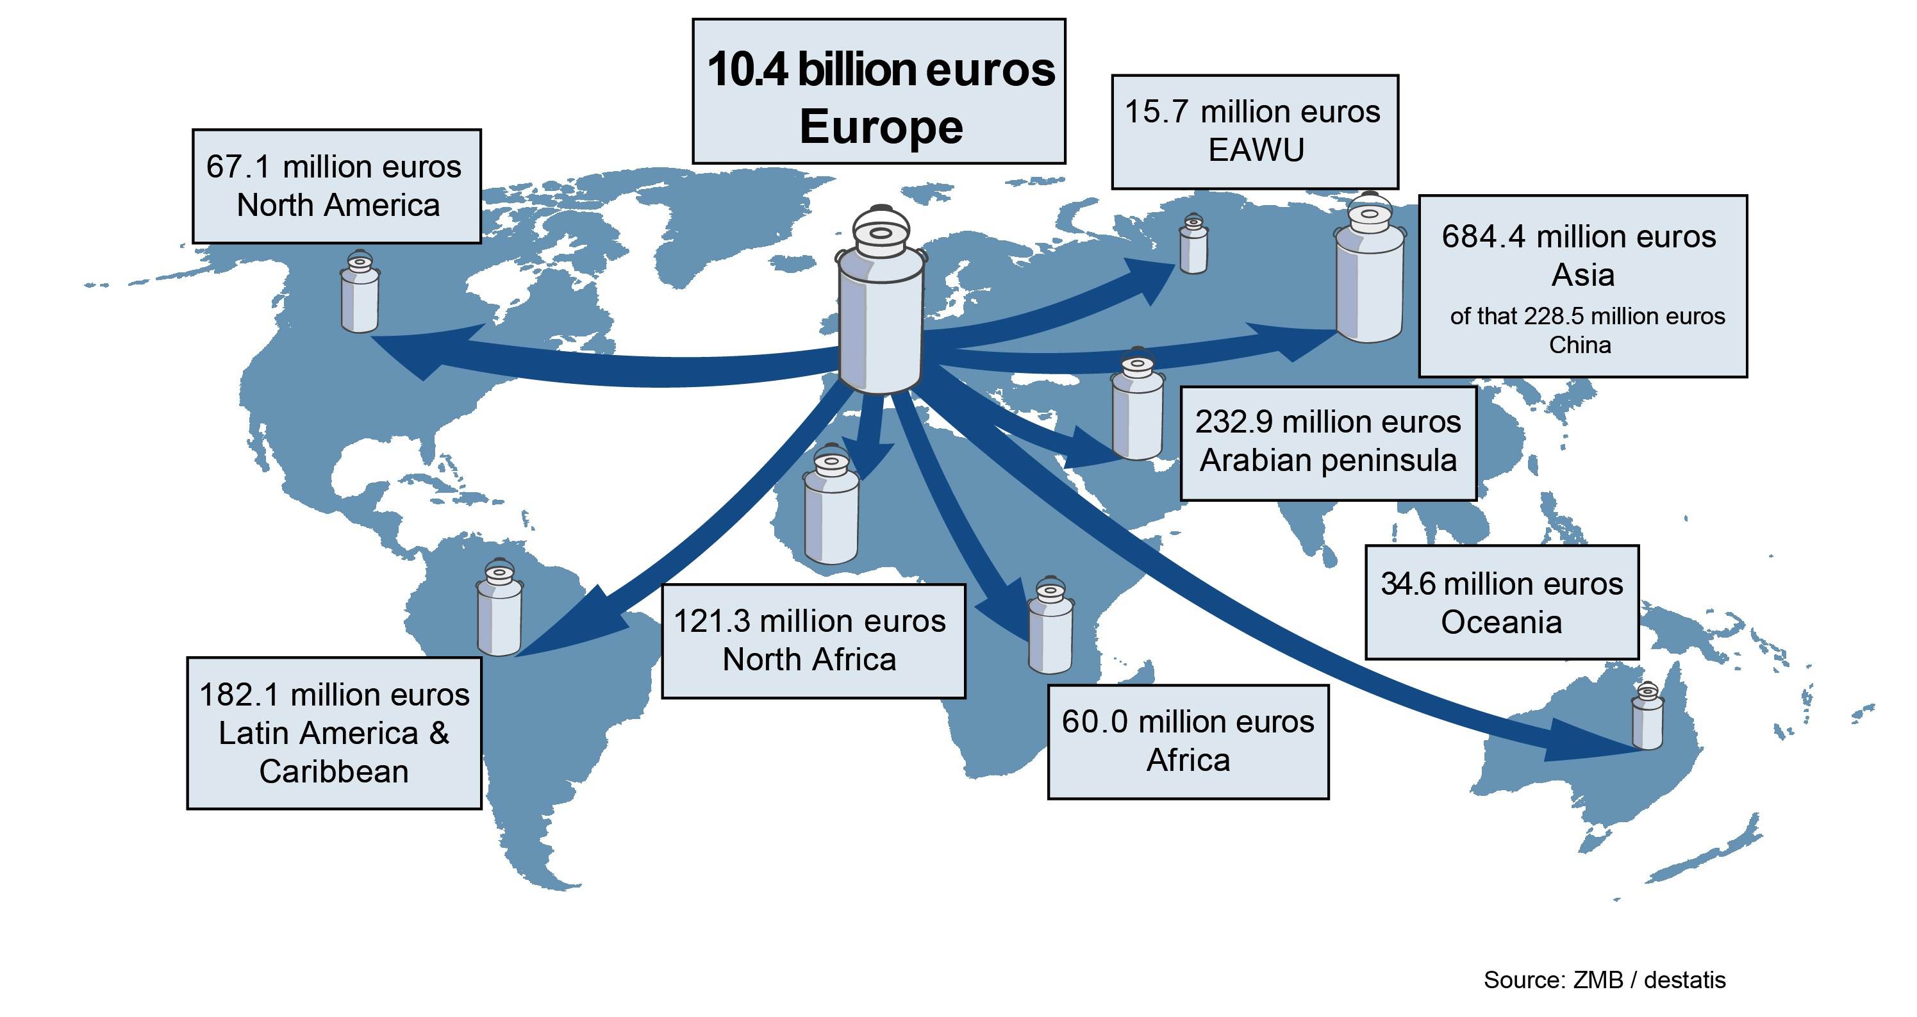
Where German Dairy Goes (2024)
Notes:
Three quarters of german dairy exports are exported within the european continent. As for the 4th quarter (third country exports), China and United Kingdom are the most significant markets.
Germany is the #1 dairy exporter in the EU by volume and value.
Key export products: cheese, butter, milk powder, whey, and lactose-based ingredients.
Strong track record in both consumer-ready and ingredient-based dairy.
Major export categories to China:
Whey protein (sports, infant nutrition)
Lactose & milk albumin (formulas, bakery)
Fresh/UHT milk and yogurt (via cross-border e-commerce)
Since 2023: shift toward higher-value products and tailored innovations

Slide 7
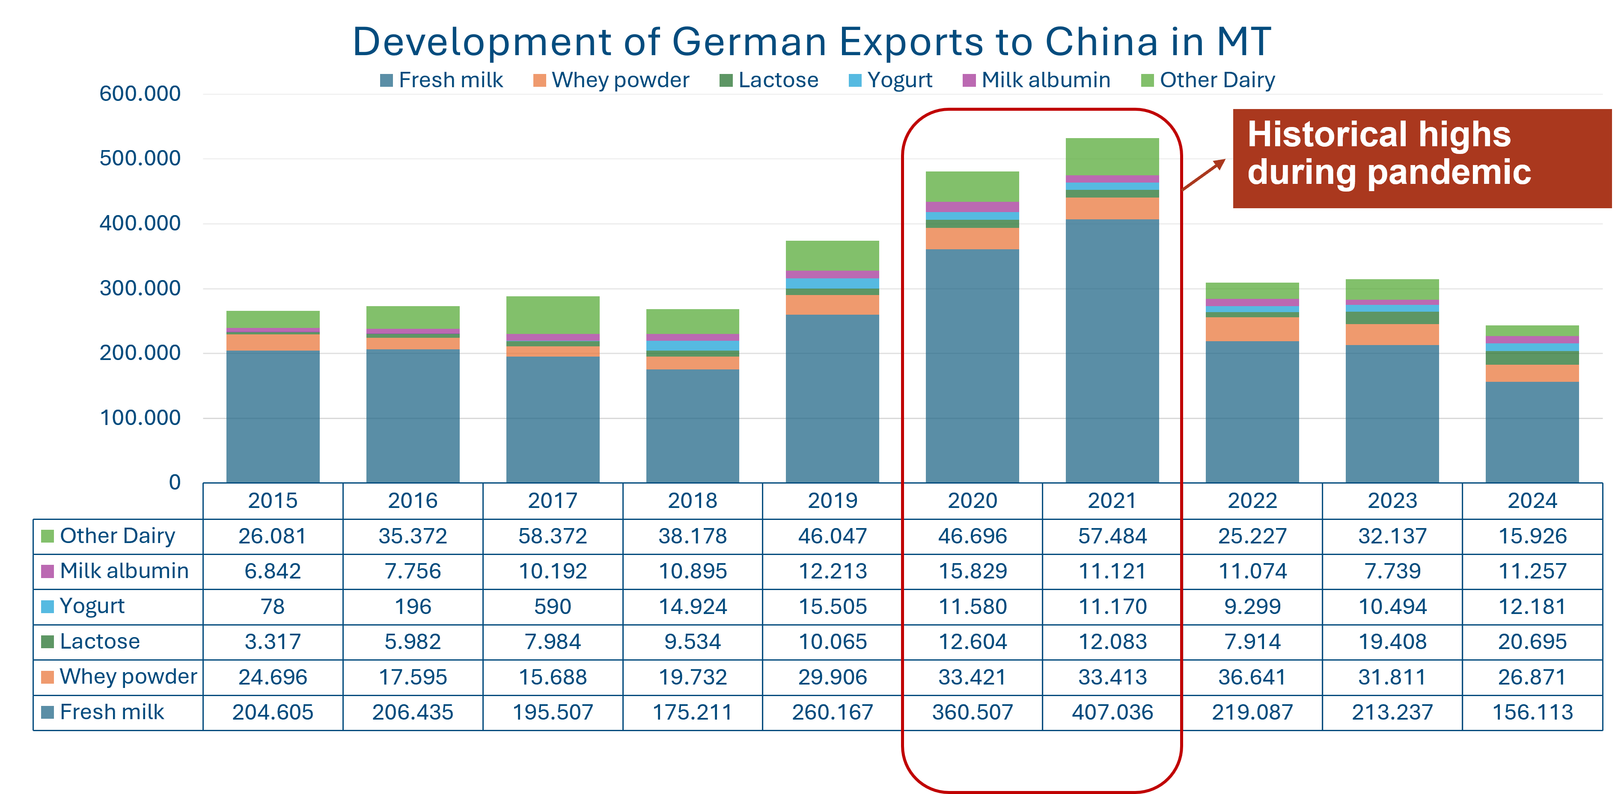
Trade in Dairy: Built on Trust, Made to Last
Notes:
Heights which were reached during COVID unmatched. Especially whole milk powder (part of „fresh milk“) came down significantly. Butter volumes up (part of „Other dairy“), even though invisible in this graph. Yogurt has seen a massive growth (urbanization and young gen demand).
ROOM FOR IMPROVEMENT

Slide 8
感谢大家的关注与支持！
Notes:
Placeholder for contact details

